Slide 1

Shree Ramswaroop Memorial University
Assignment JavaScript
Submitted to : Kshitiz Srivastava
Submitted By : Mukesh Prajapati
Branch : B . tech (cs industry integrated)
Roll-No : 202410101230007

Slide 2
Weather Application Project

Slide 3
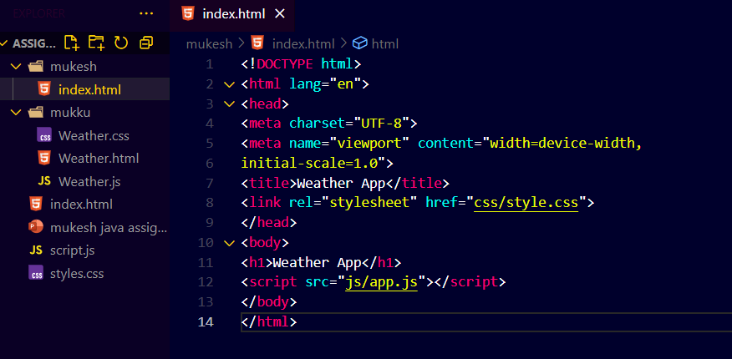
Experiment:--1
Setting up Project Structure and Files
HTML Code:-

Slide 4
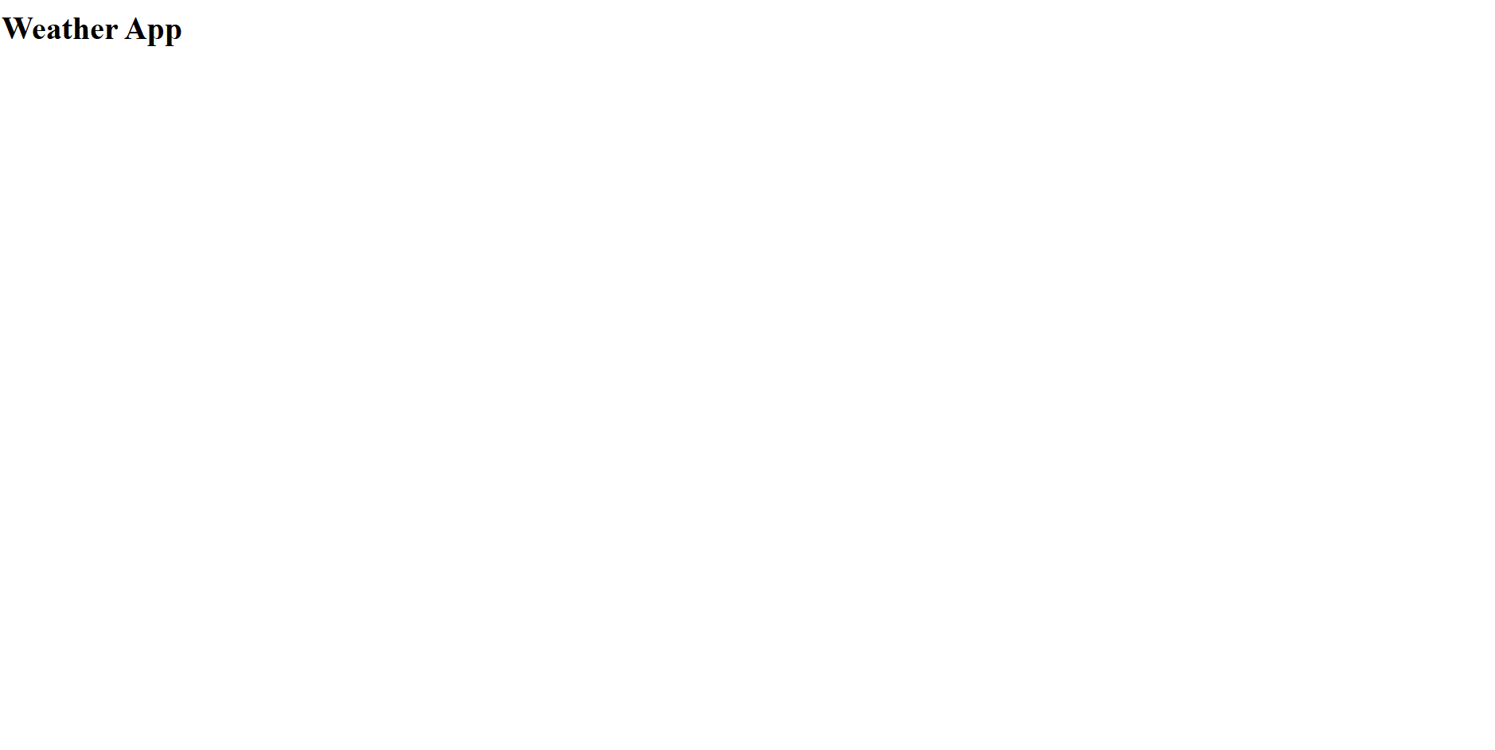
Output of the given code:--

Slide 5
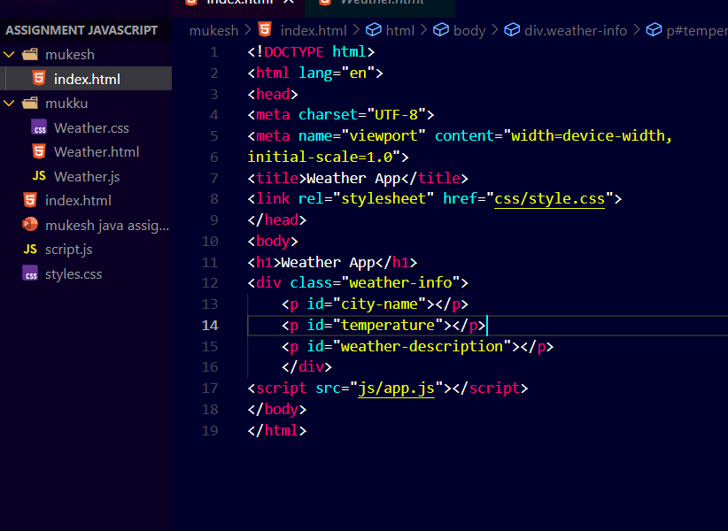
Experiment:--2
Basic HTML Structure for Weather Application
HTML Code:

Slide 6
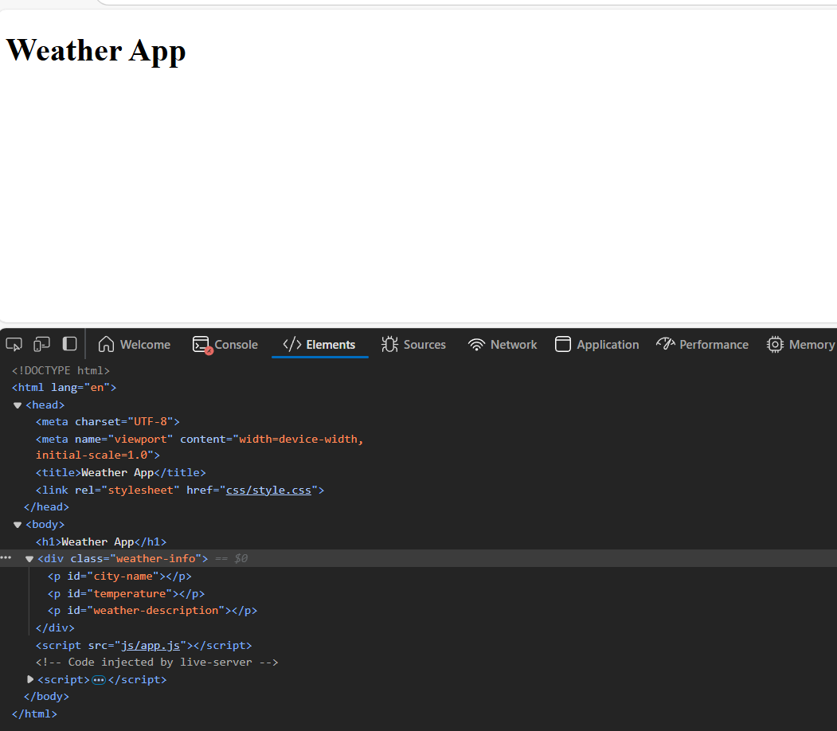
Output of the Above Result:

Slide 7
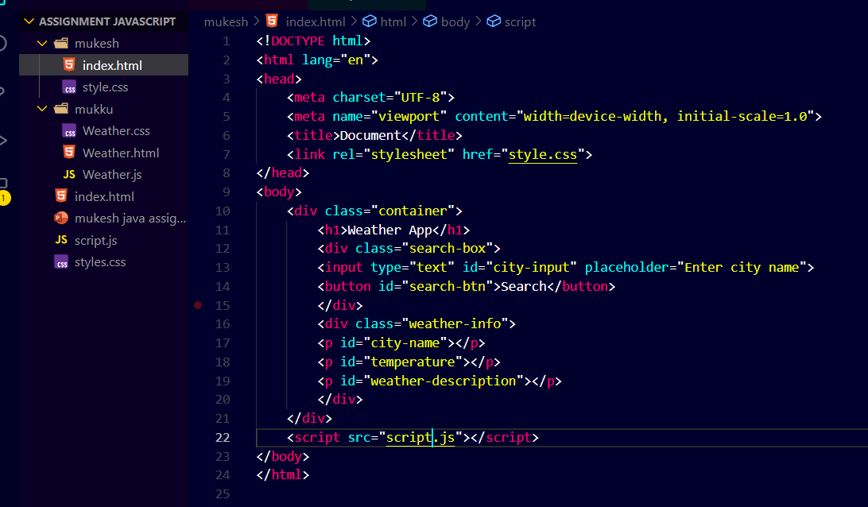
Experiment:-3
Apply CSS Styles to HTML Elements:-
HTML Codes:-

Slide 8
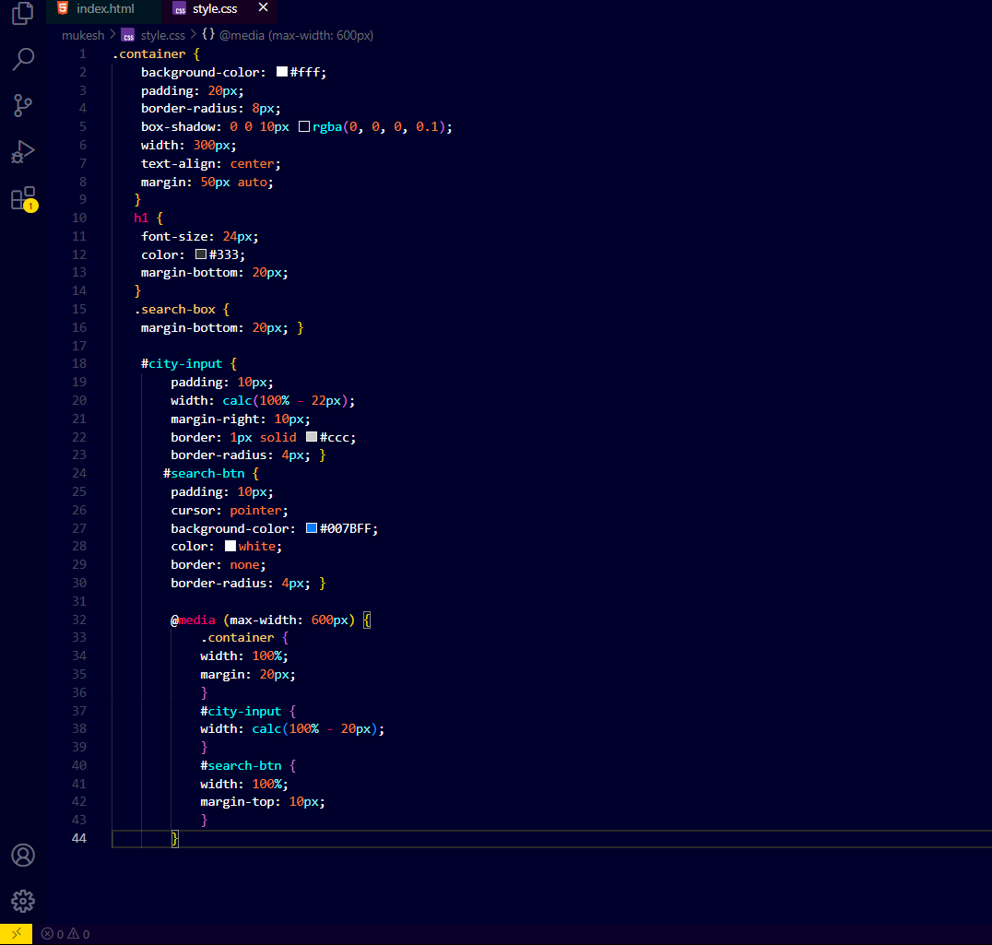
CSS Codes:-

Slide 9
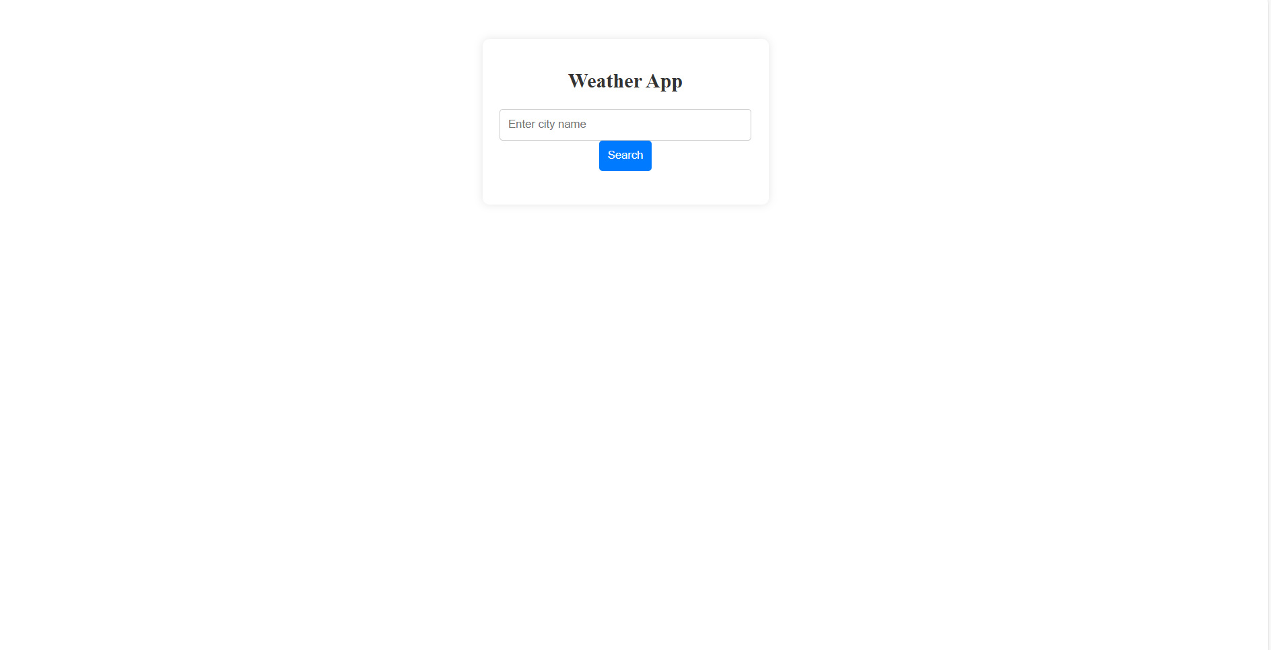
Output of the Experiment:-3

